Slide 1
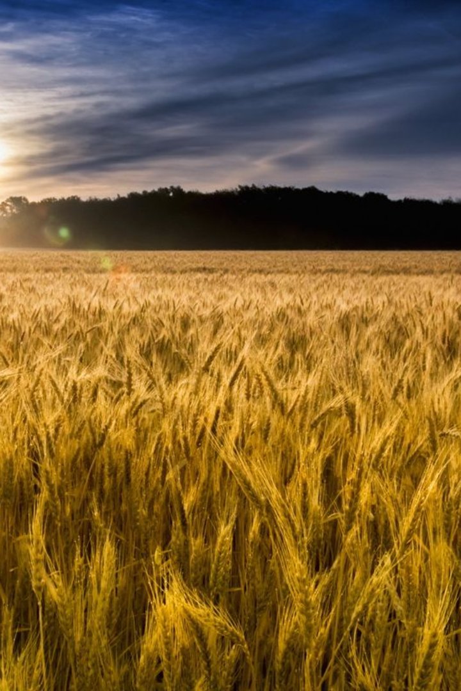
US FARMERS Wheat Classification Using Machine Learning
Welcome to the US wheat classification! In this presentation, we will explore the types of wheat the power of machine learning, and the exciting future of wheat classification.
by Aniket Chavan

Slide 2
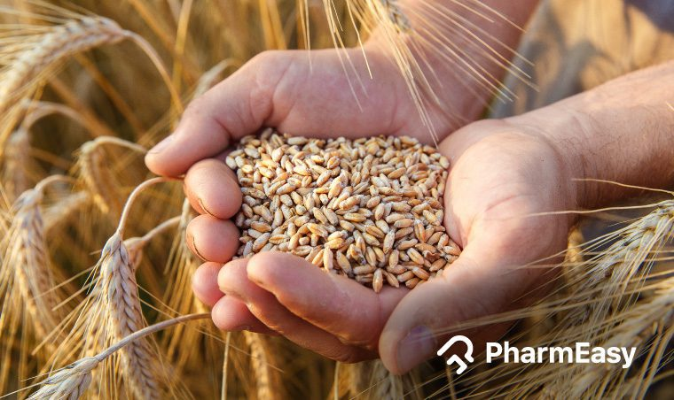
AS
OBJECTIVE :
The objective of this project is to analyse variety
of Wheat In US by using the
Machine Learning models / Algorithms like :
Model Selection and Evaluation
Logistic regression
SVM
KNN
SVMs are particularly good at solving binary classification problems, which require classifying the elements of a data set into two groups.
. The number of nearest neighbors to a new unknown variable that has to be predicted or classified is denoted by the symbol 'K'.
It is a classification model, which is very easy to realize and achieves very good performance with linearly separable classes.

Slide 3
Methodology :
PROBLEM DEFINATION
DATA COLLECTION
DATA PREPROCESSING
MODEL BUILDING
FEATURE ENGINEERING
EDA
TUNNING THE MODEL
MODEL DEPLOYMENT

Slide 4
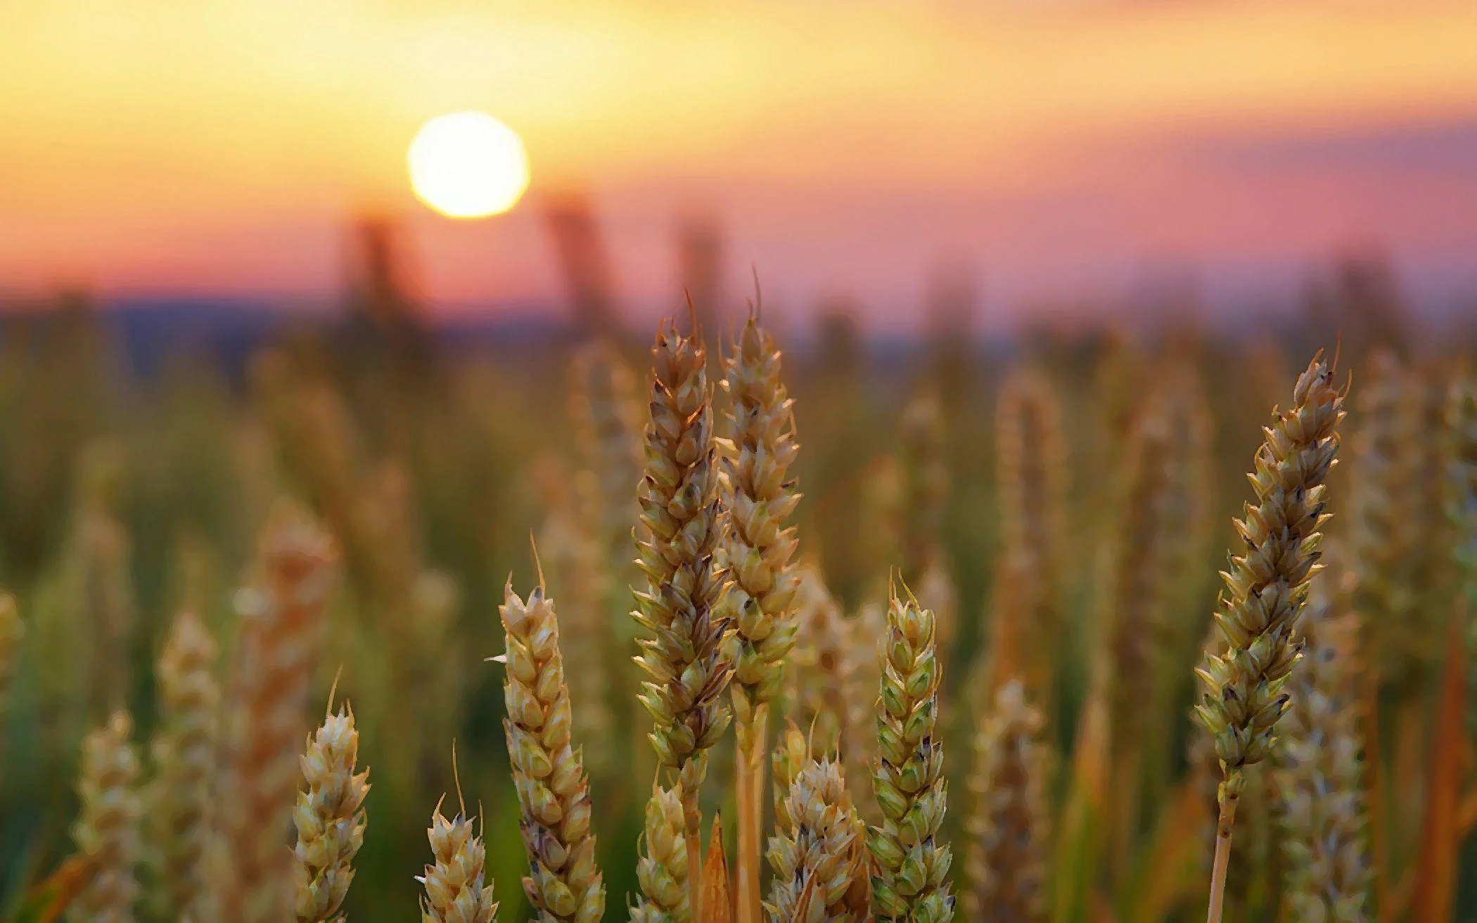
Machine Learning in Wheat Classification
Machine learning offers a revolutionary approach to wheat classification by leveraging patterns and algorithms. With trained models, accurate predictions and faster results can be achieved.

Slide 5
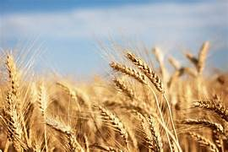

Types of Wheat and Current Classification
ROSA
KAMA
Known for its high protein content and strong gluten, ideal for baking bread and making pasta.
Preferred for pastry and cakes due to its lower protein content. Also used for animal feed.
CANADIAN
Canada Western Red Spring (CWRS) wheat, boasting a high protein content for superior milling, bread and noodle quality.

Slide 6

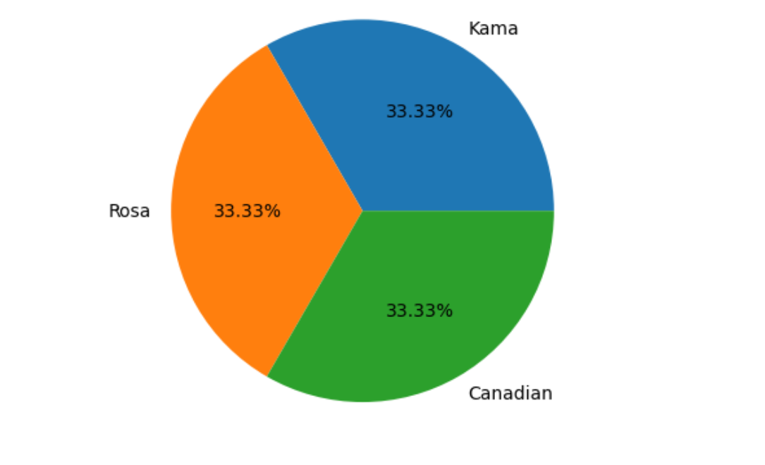

TYPES OF WHEAT IN DATASET

Slide 7
RESULT :
BEFORE TUNNING:
RESULTS | LOGISTIC REGRESSION | SVM | KNN
ACCURACY | 93 | 95 | 95
PRECISION | 86 | 87 | 87
RECALL | 92 | 100 | 1.00
F1- SCORE | 89 | 93 | 93

Slide 8
RESULT :
AFTER TUNNING:
RESULTS : | LOGISTIC REGRESSION | SVM | KNN
ACCURACY | 95 | 93 | 95
PRECISION | 92 | 86 | 87
RECALL | 92 | 92 | 1.00
F1- SCAORE | 92 | 89 | 93
LOGISTIC REGRESSION

Slide 9
FINAL RESULTS BY ANALYSING
RESULTS BEFORE TUNNING AND
AFTER TUNNING
After performing different types of algorithm on the Wheat classification dataset
we could see that each algorithm's model perform differently in order to classify
the data and providing accuracy of doing the same.
from the table above we can clearly conclude that the logistic regression model is
performing well on the dataset giving us accuracy of 92 %.

Slide 10
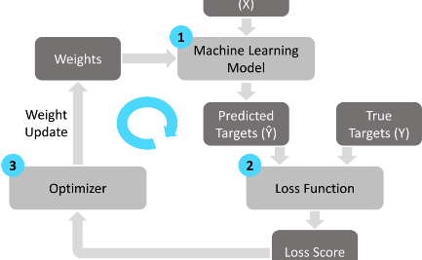


Results and Future Directions
Promising Results
Improving Yield and Quality
Embracing Innovation
Machine learning models have demonstrated high accuracy in classifying wheat types, accelerating the process and reducing errors.
The future holds exciting potential in combining other digital technologies such as drones and IoT for precision agriculture.
Further research aims to utilize ML for predicting wheat yield and enhancing breeding processes for higher quality crops.

